Slide 1
Diamond Price Prediction
The Data Incubator Project Proposal
Yanyan Jiang

Slide 2
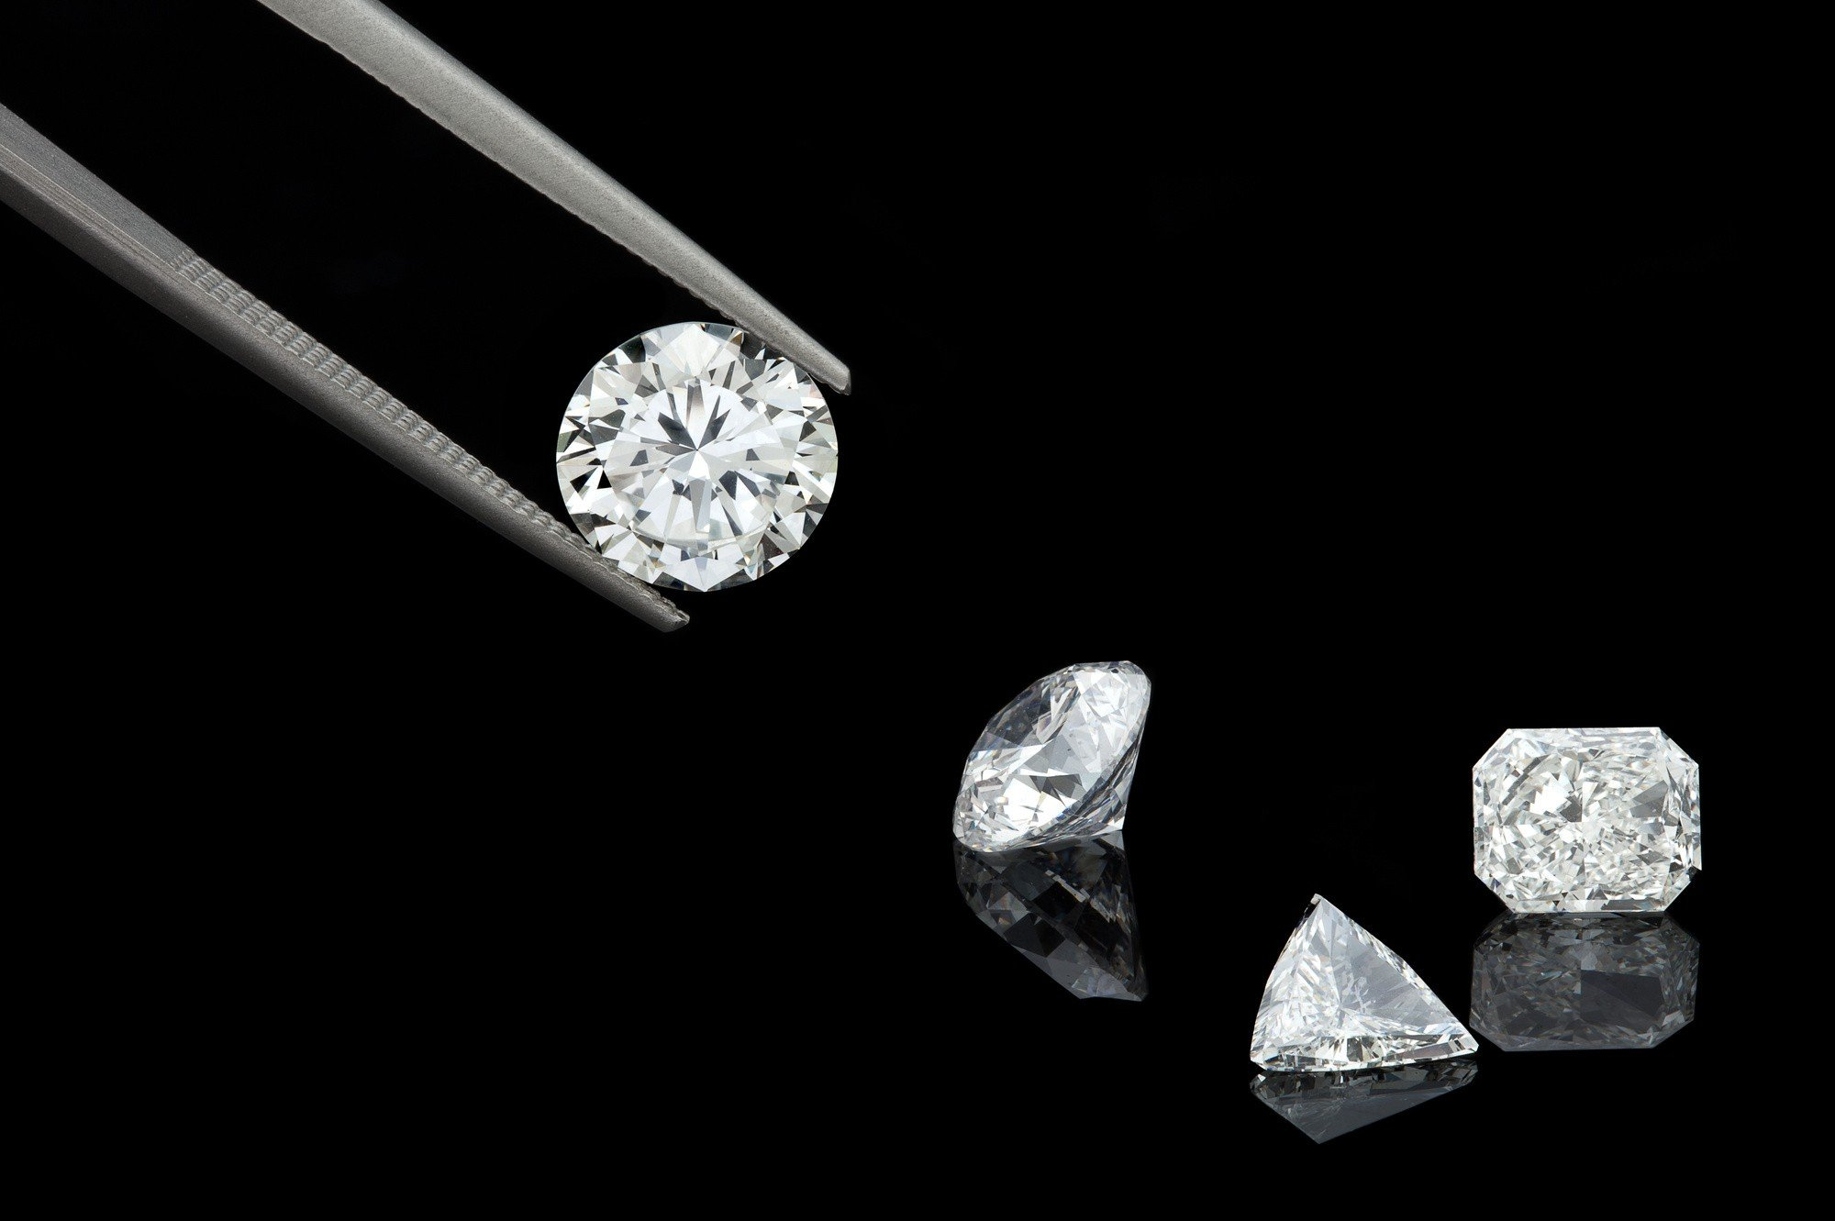
Introduction
Most people (80%, 2019 survey) buy a diamond engagement ring
Build a model that can predict diamonds’ market prices and give customers advices on how to pick the best diamond without overpaying too much
Notes:
According to the Vogue survey in 2019, more than 80 percent people get a diamond engagement ring. So the question is how to find the perfect diamonds and get the most bang for your buck. For those people who purchase the diamond first time, they usually spend lot of time browsing the internet and learn how to read the diamond grading reports. It’s really a time-consuming thing, and admittedly, expensive thing.

Slide 3
Dataset Preparation
Collect data from the official BlueNile website: https://www.bluenile.com/diamond-search
Download HAR files for diamonds that are larger than 1.2 carat
Keep the diamonds whose prices are lower than $30,000
Data size: 9,985 unique diamonds with 10 different features
Notes:
First step is about collect ting data. For this project, I downloaded all the diamonds from BlueNile that are larger than 1.2 carat and lower than 30,000 dollars. The final data size is 9985 diamonds with 10 different features. And then if you go to next slide…

Slide 4
Feature | Numerical type
Carat | Float
Clarity | Category ([‘FL’, ‘IF’, ’VVS1’, ‘VVS2’, ‘VS1’, ‘VS2’, ‘SI1’, ‘SI2’])
Color | Category ([‘D’, ‘E’, ‘F’, ‘G’, ‘H’, ‘I’, ‘J’, ‘K’])
Culet | Category ([‘None’, ‘Pointed, ’Very Small, ‘Small’, ’Medium’, ’Slightly Large’ ,’Large’])
Cut | Category ([‘Astor Ideal’, ‘Ideal’, ‘Very Good’, ’Good’])
Depth | Float
Fluorescence | Category ([‘None’, ‘Faint’, ‘Faint Blue’, ‘Medium’, ‘Medium Blue’, ’Strong’, ‘Strong White’, ‘Strong Yellow’, ‘Strong Blue’, ‘Very Strong Blue’, ‘Very Strong’])
IxwRatio | Float
Polish | Category ([‘Excellent’, ‘Very Good’, ‘Good’])
Symmetry | Category ([‘Excellent’, ‘Very Good’, ‘Good’])
Table | Float
Notes:
You would see the 10 different features including carat, color, cut, depth, table etc and their corresponding numerical types. And going to next slides..

Slide 5
Data Statistics
Label | Mean | Std | Min | Max
Price | 14,387.39 | 6,592.27 | 3,375.00 | 29,995.00
Carat | 1.56 | 0.33 | 1.20 | 3.06
Clarity | 5.56 | 1.70 | 1 | 8
Color | 4.54 | 2.08 | 1 | 8
Culet | 1.09 | 0.43 | 1 | 5
Cut | 2.12 | 0.37 | 2 | 4
Depth | 62.16 | 1.20 | 55.30 | 71.20
Fluorescence | 2.23 | 2.08 | 1 | 11
IxwRatio | 1.00 | 0.004 | 1.00 | 1.03
Polish | 1.05 | 0.25 | 1 | 3
Symmetry | 1.13 | 0.37 | 1 | 3
Table | 58.09 | 1.85 | 50.00 | 79.00
Notes:
It is the data statistics which would give you a roughly idea of how the features and prices look like.

Slide 6
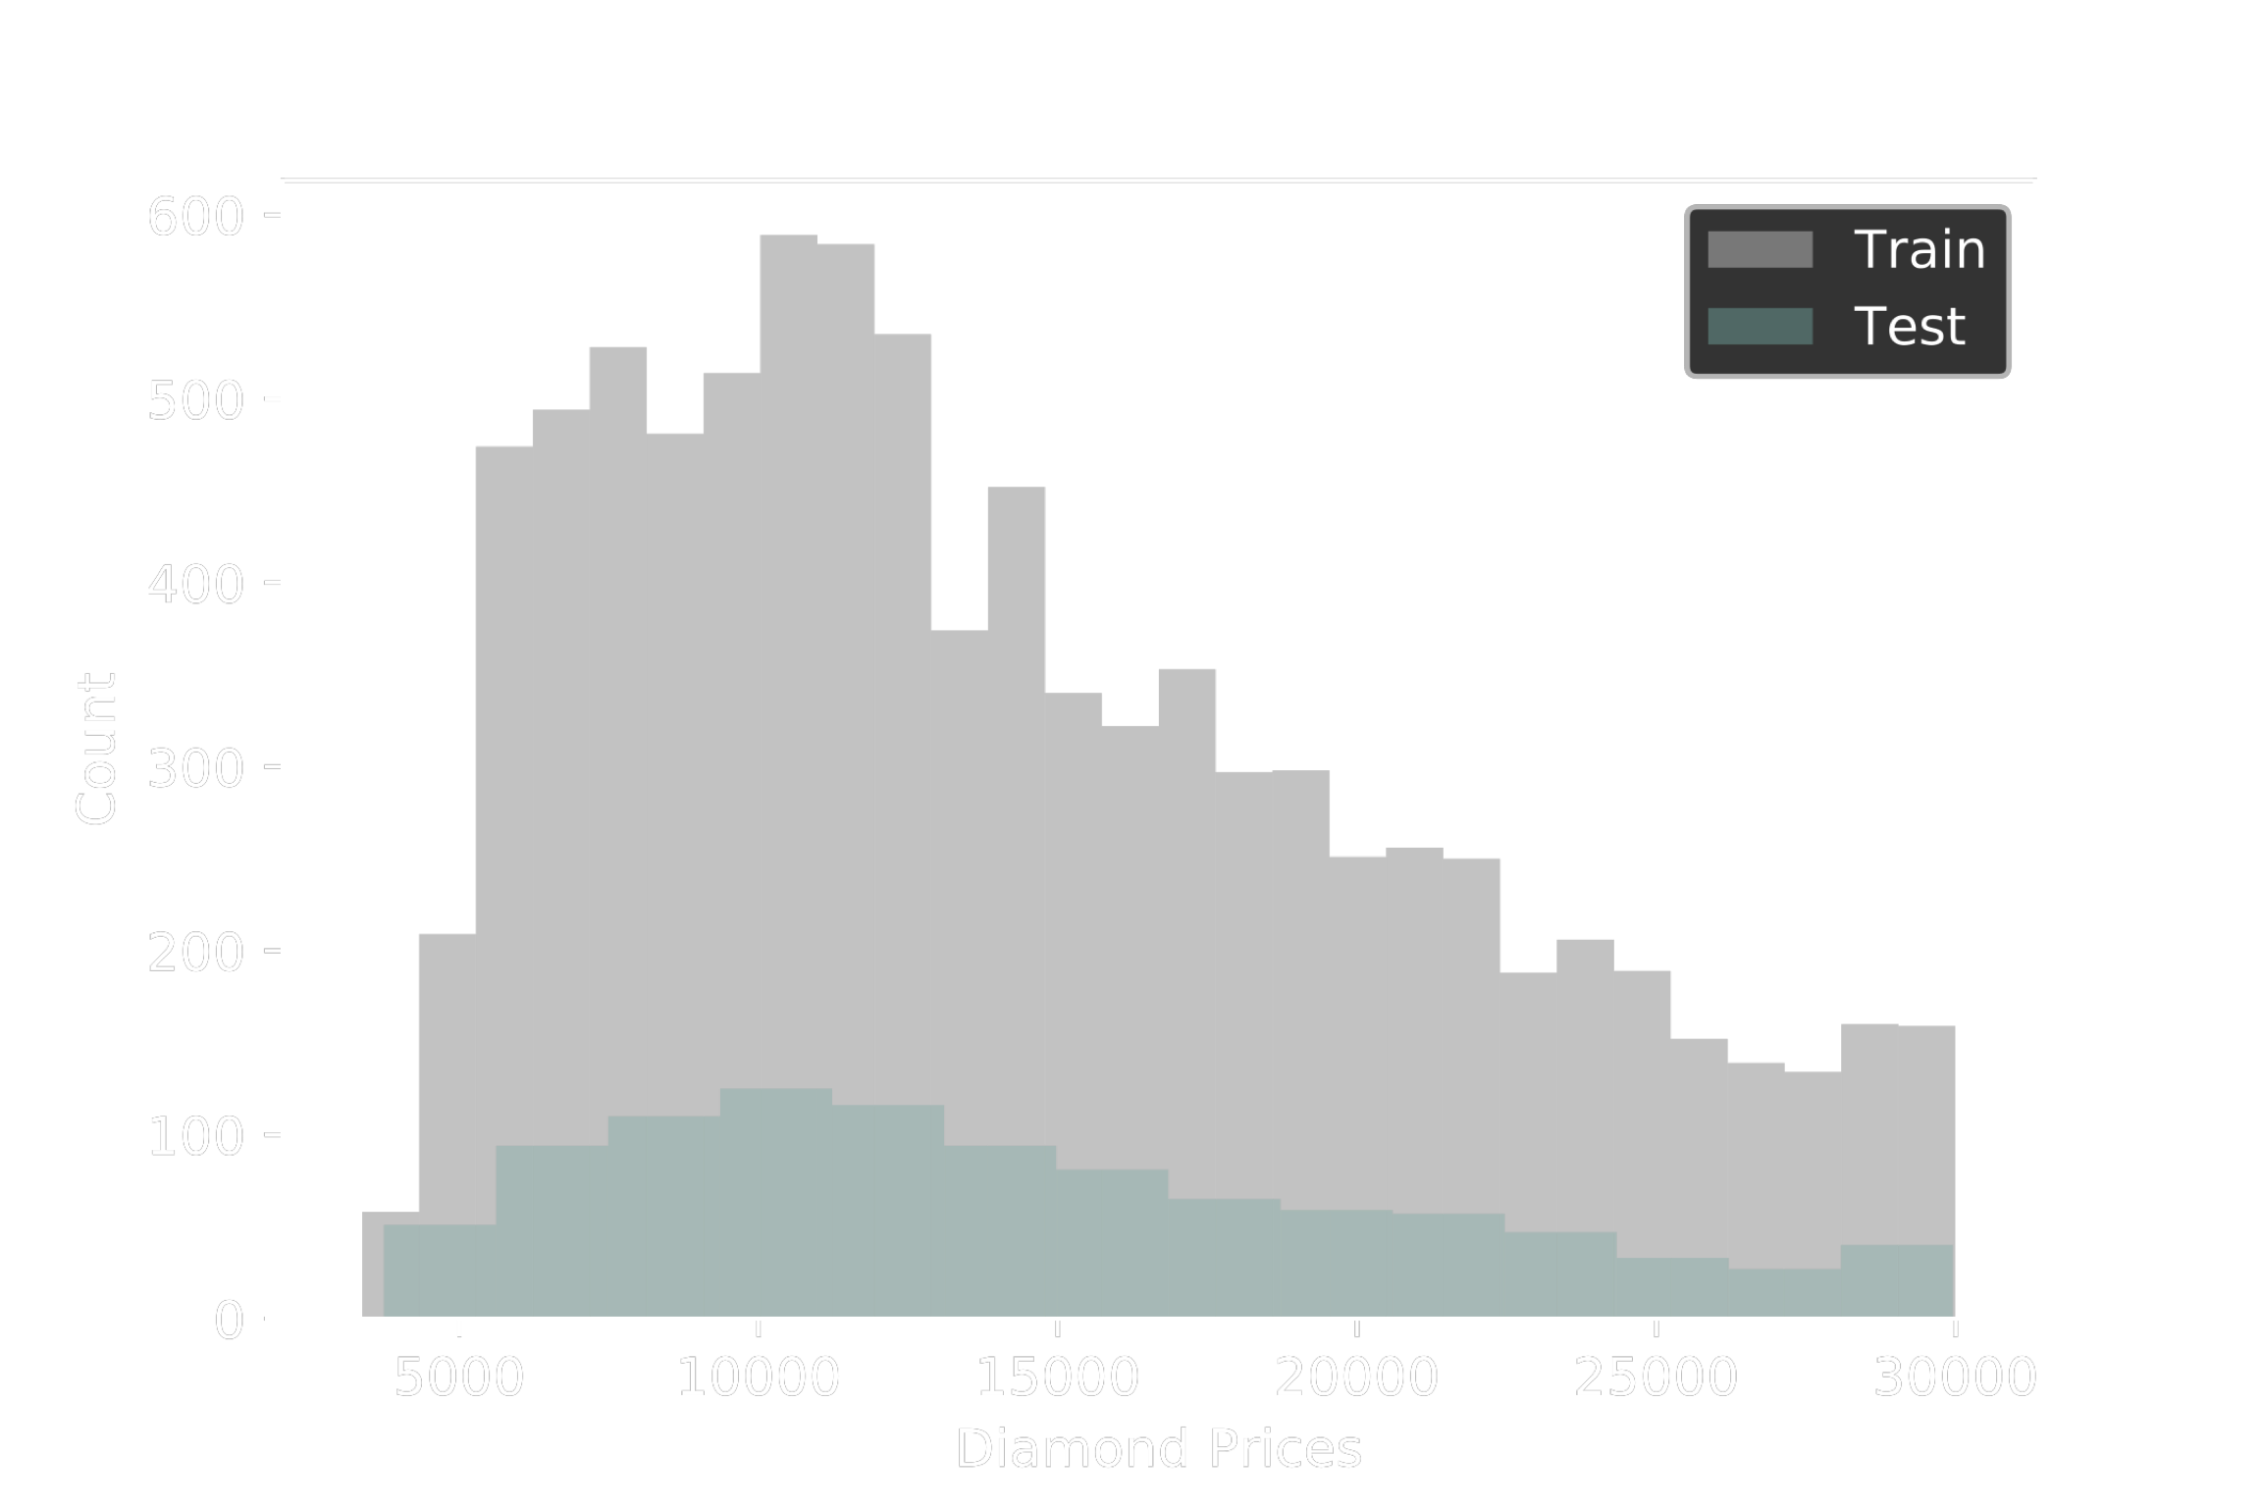
Train set & Test set
Randomly split the data into train set and test set
Train/Test size: 8,986/999
Notes:
Once I prepared the data, I randomly split it into the train set and test set. On right hand side you can see the distribution of the prices in the train set and test set. So I will train my model on my train set and then test it on the test set.

Slide 7

Linear Regression
MAE = 1,640.70
R² = 0.90
Notes:
I tried three different models. The first model is the simple linear regression. Here in the figure it’s the scatter plot between the actual and predicted prices. And the model’s performance in terms of MAE is , R2,

Slide 8

Support Vector Machine
MAE = 966.82
R² = 0.96
Notes:
The second model I used is SVM. You can see the performance is better than linear regression. MAE is down to 966.82 and r^2 is 0.96

Slide 9

XGBoost
MAE = 728.71
R² = 0.98
Notes:
The last one is XGBoost. This one gave me the best performance with 728.17 MAE and 0.98 R^2

Slide 10

XGBoost
Notes:
This slides shows the feature importance analysis under XGBoost. Carat and depth play the most important role in diamond price prediction.

Slide 11
Thank you

